Slide 1
Mobile Application Development
David Drohan (ddrohan@wit.ie)

Slide 2
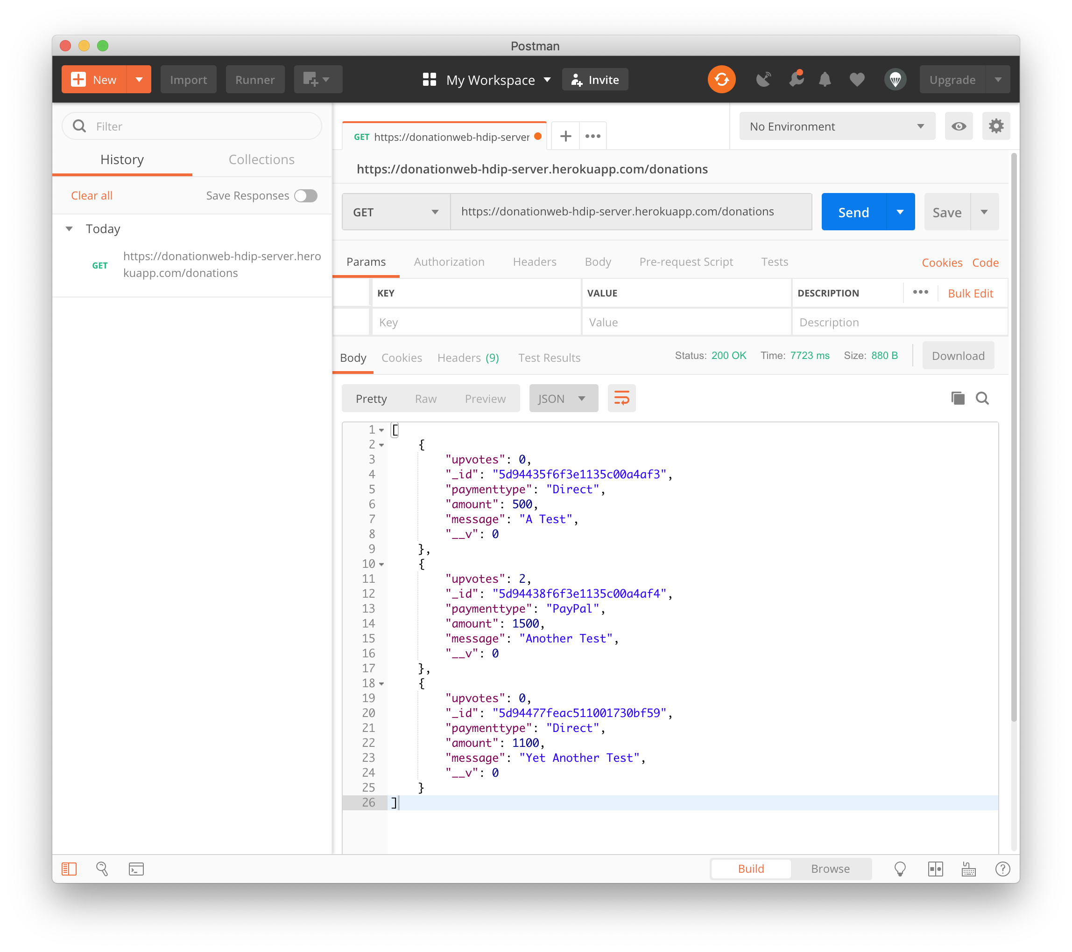
Donation Web App Overview

Slide 3
Donation Web App
A Node Web Server to manage donations made to ‘Homers Presidential Campaign ’
App Features (all via RESTful API)
POST payment type, donation amount & message in JSON format
GET a list of donations
GET an individual donation using an ID
DELETE an individual donation using and ID
Upvote a donation via PUT request
Persistence via MongoDB deployed to Heroku

Slide 4
Donation Web App – ‘routes’
app.get('/donations', donations.findAll)
app.get('/donations/votes', donations.findTotalVotes)
app.get('/donations/:id', donations.findOne)
app.post('/donations',donations.addDonation)
app.put('/donations/:id', donations.editDonation)
app.put('/donations/:id/vote', donations.incrementUpvotes)
app.delete('/donations/:id', donations.deleteDonation)

Slide 5
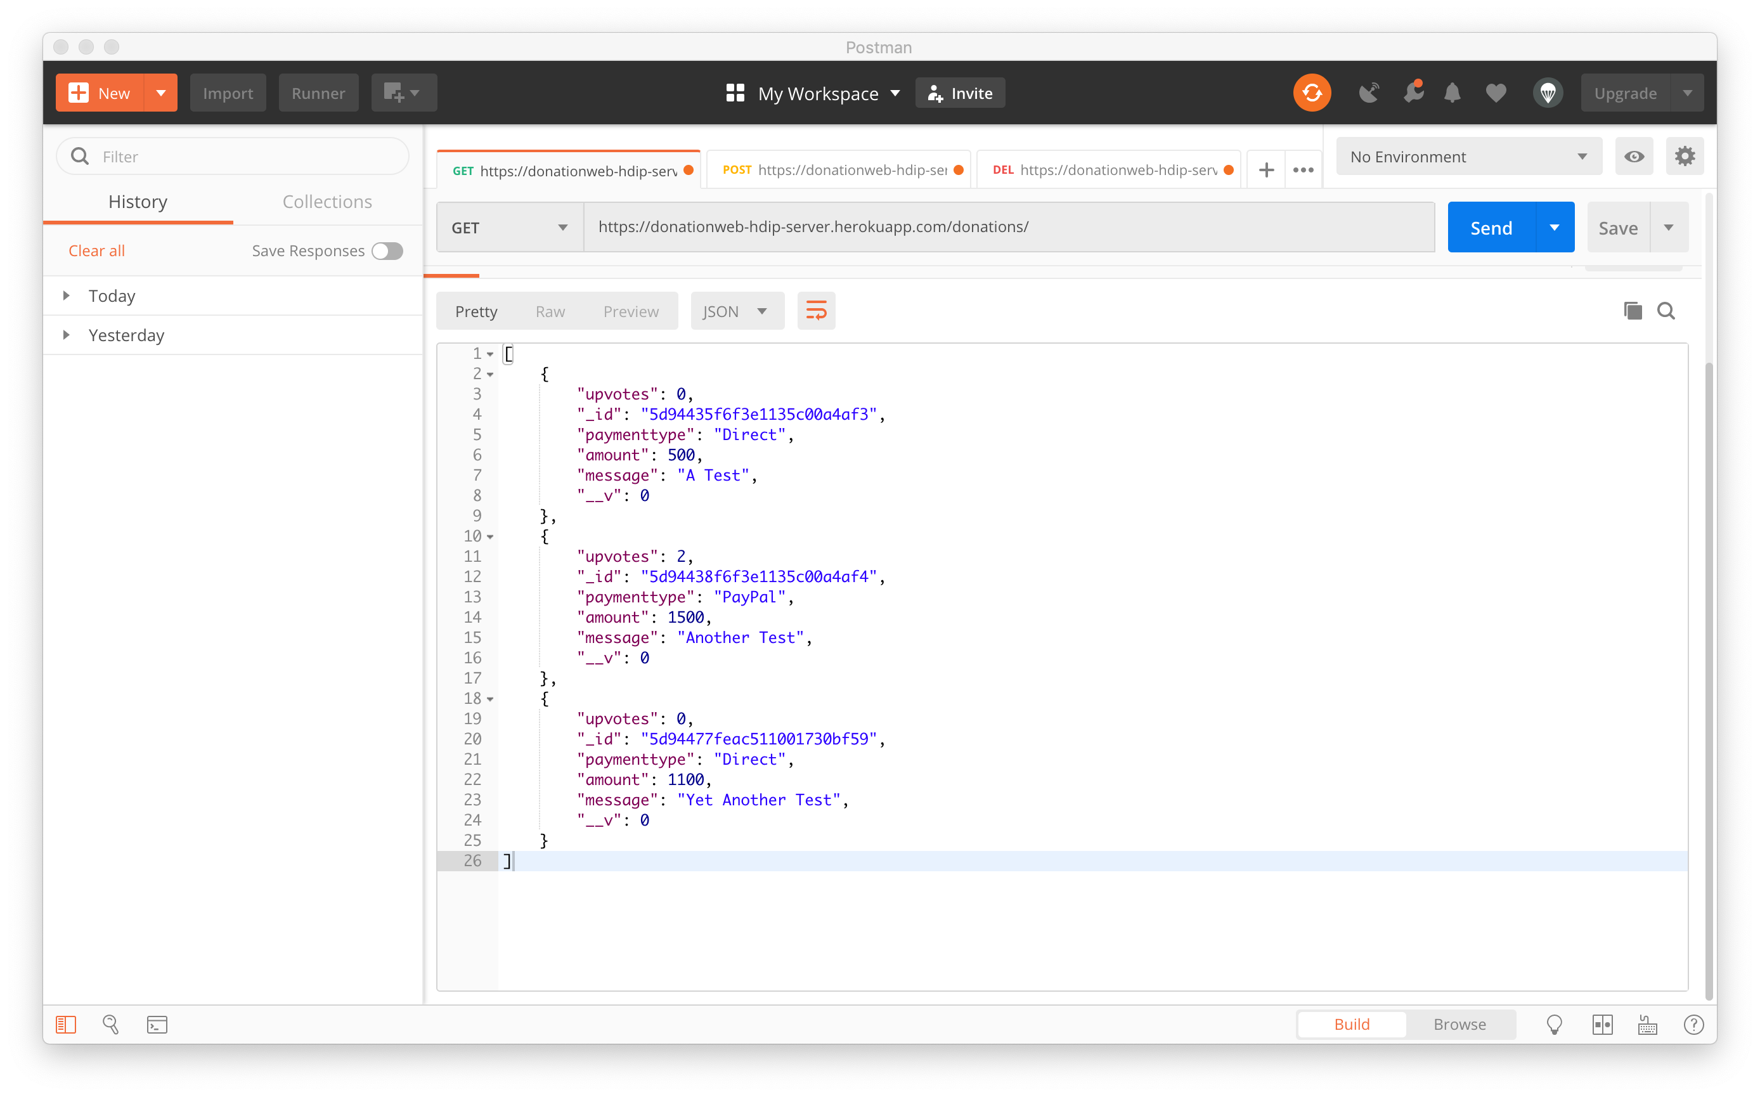
app.get('/donations', donations.findAll)

Slide 6
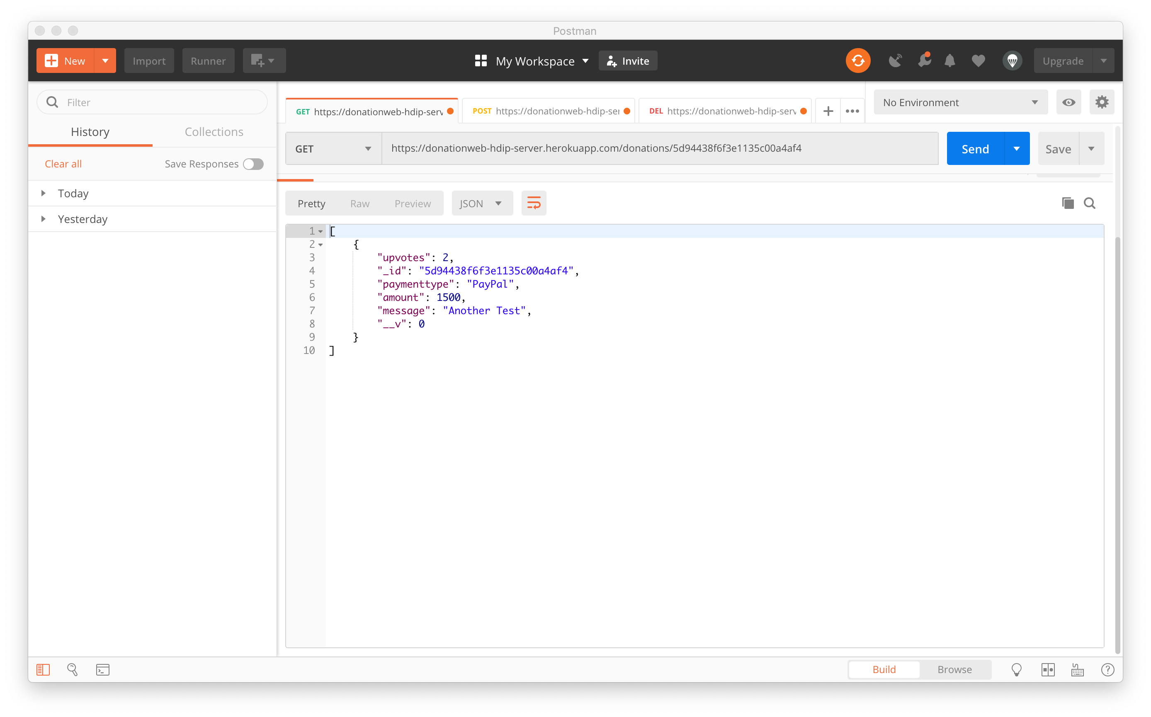
app.get('/donations/:id', donations.findOne)

Slide 7
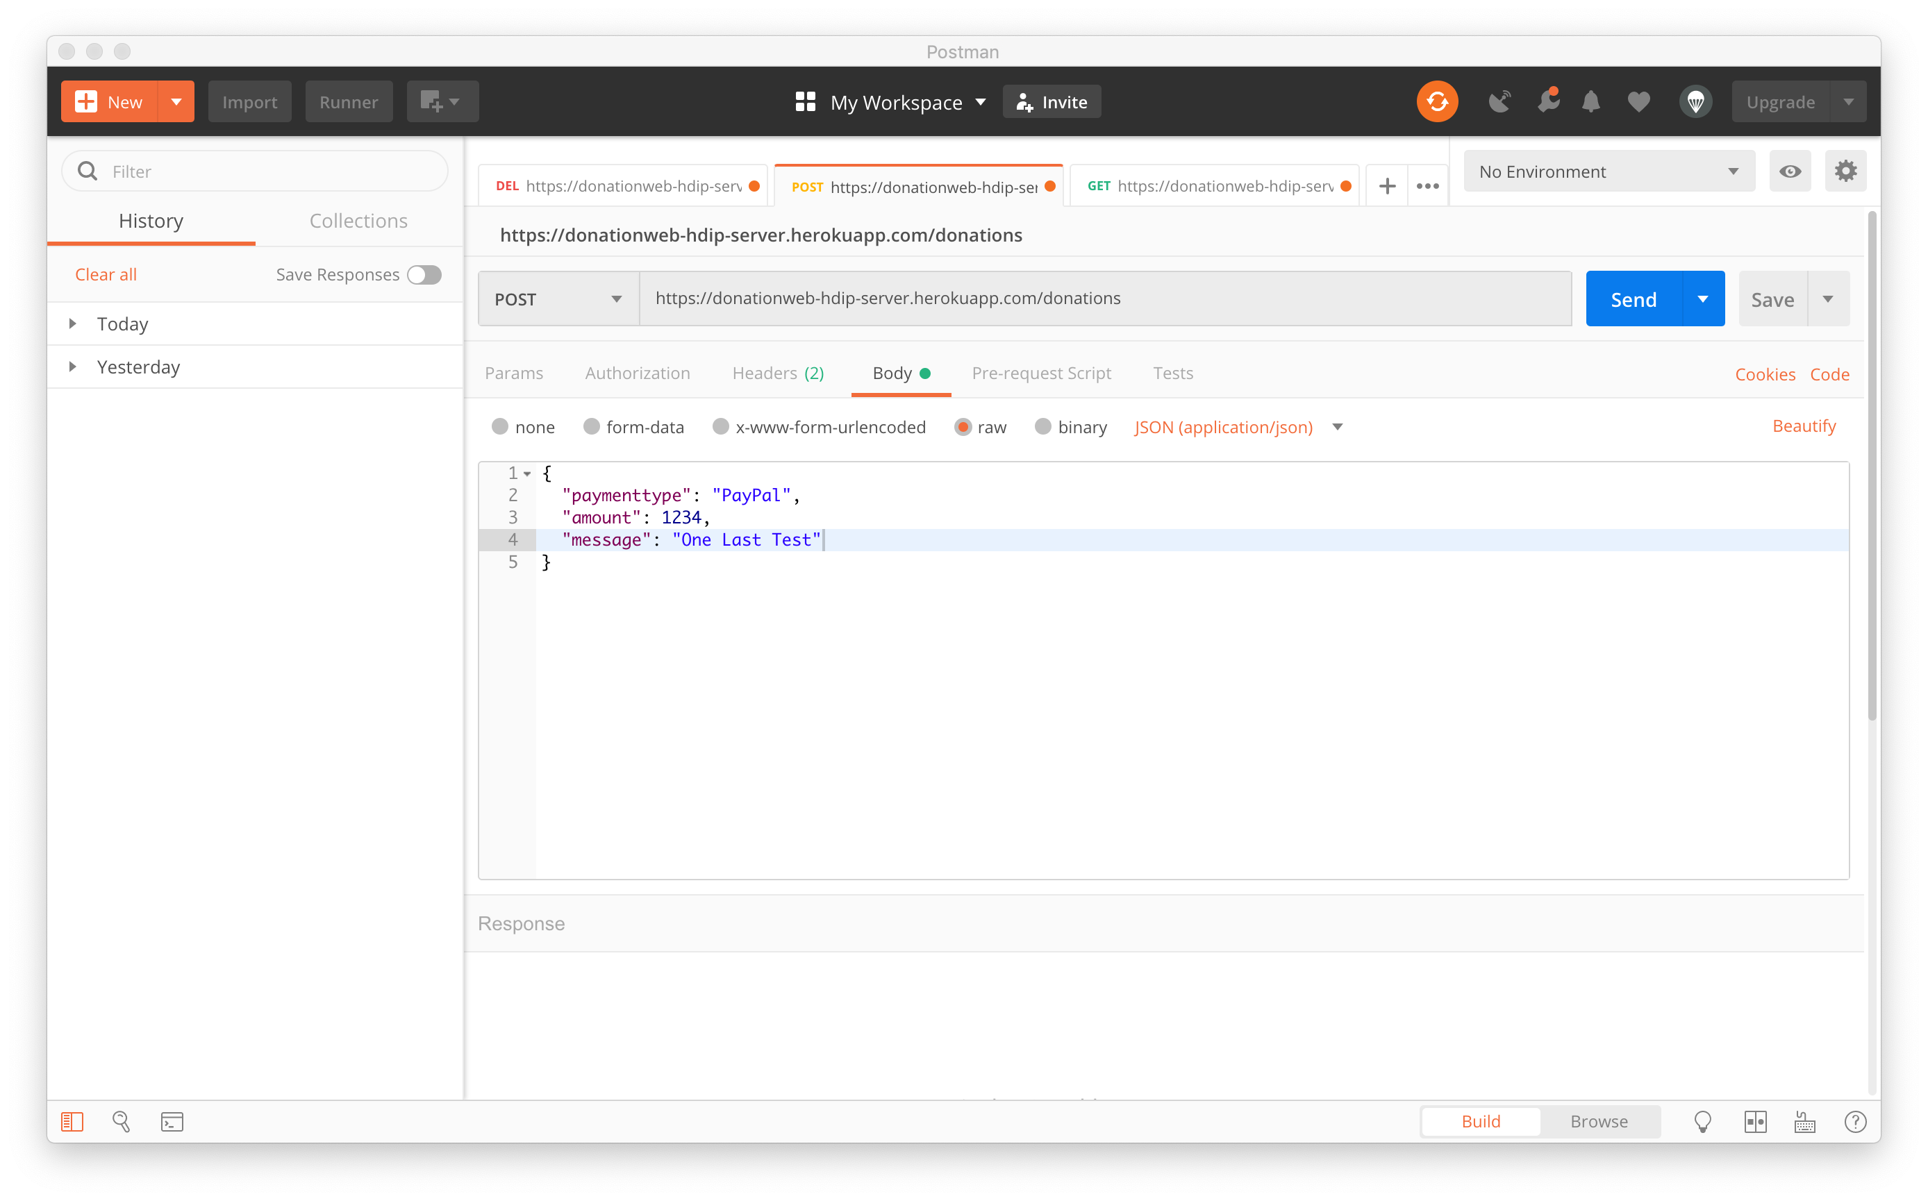
app.post('/donations',donations.addDonation)

Slide 8
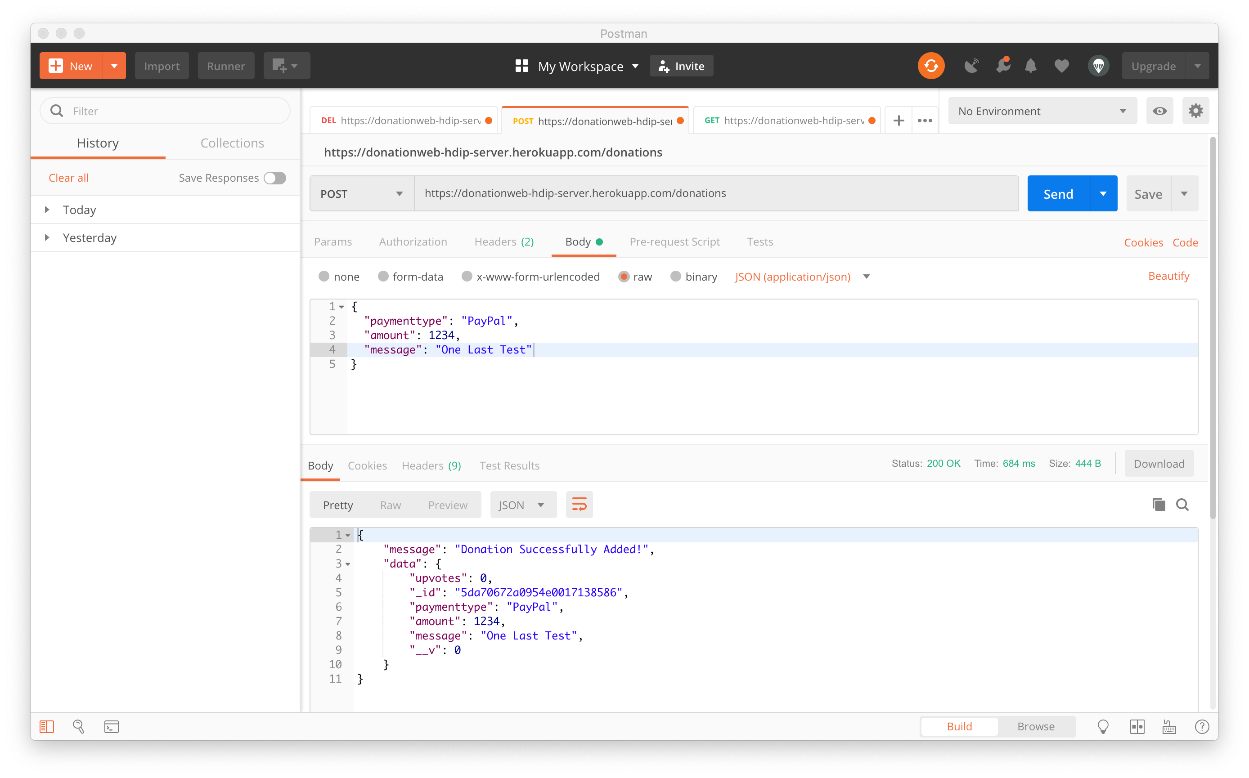
app.post('/donations',donations.addDonation)

Slide 9
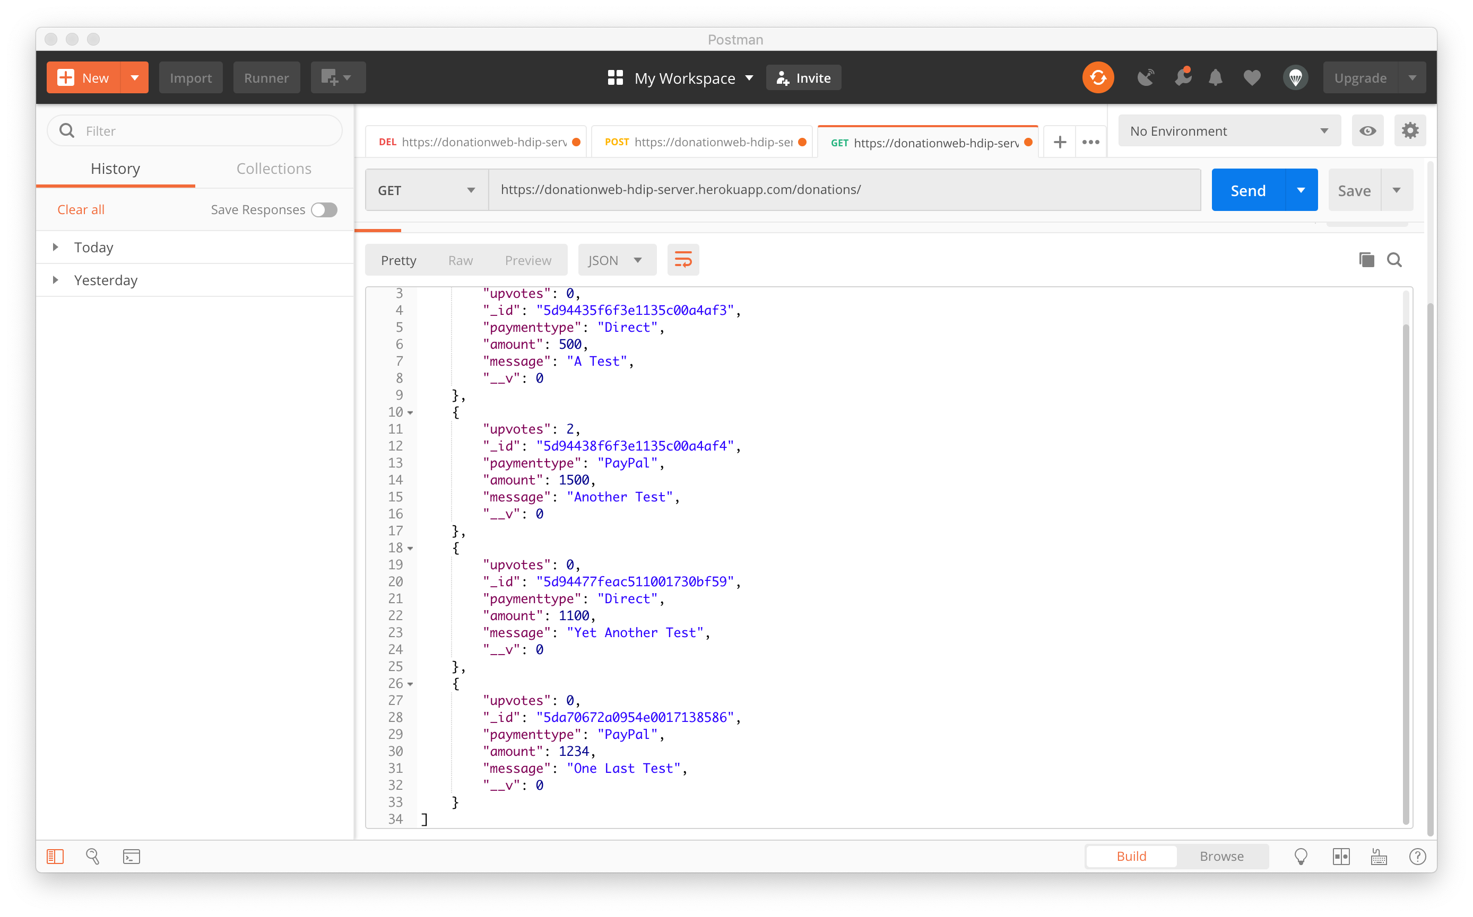
app.post('/donations',donations.addDonation)

Slide 10
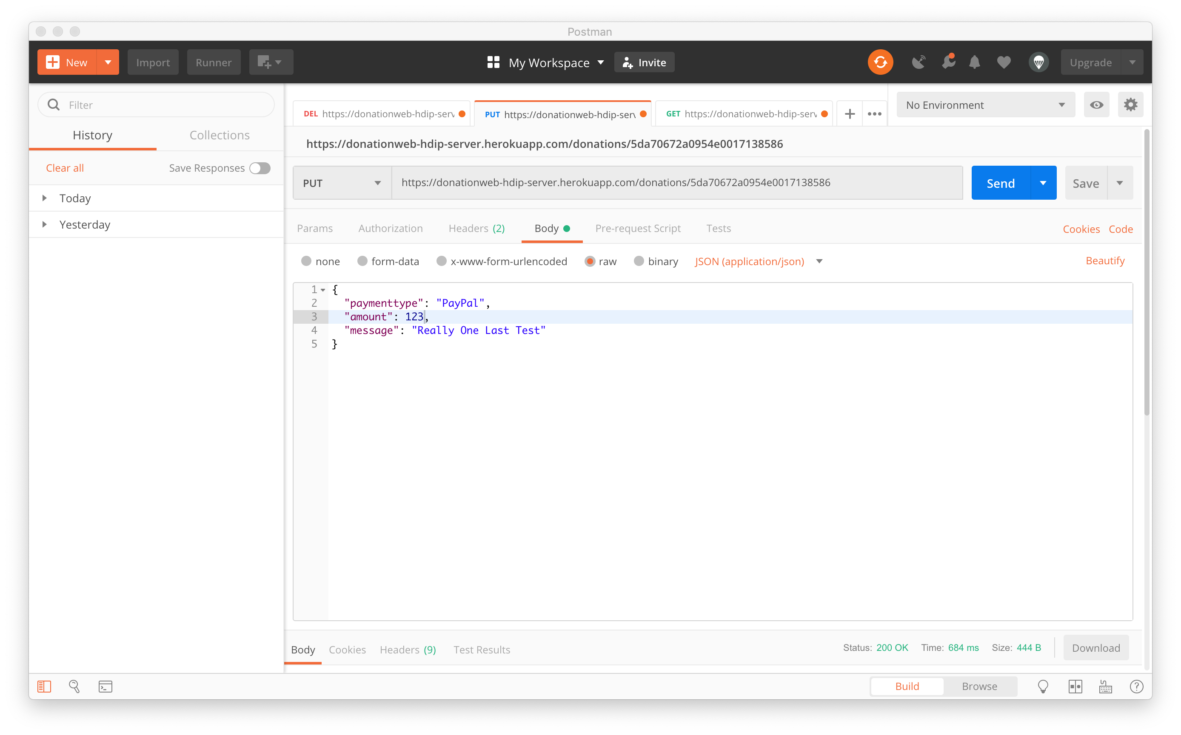
app.put('/donations/:id', donations.editDonation)

Slide 11
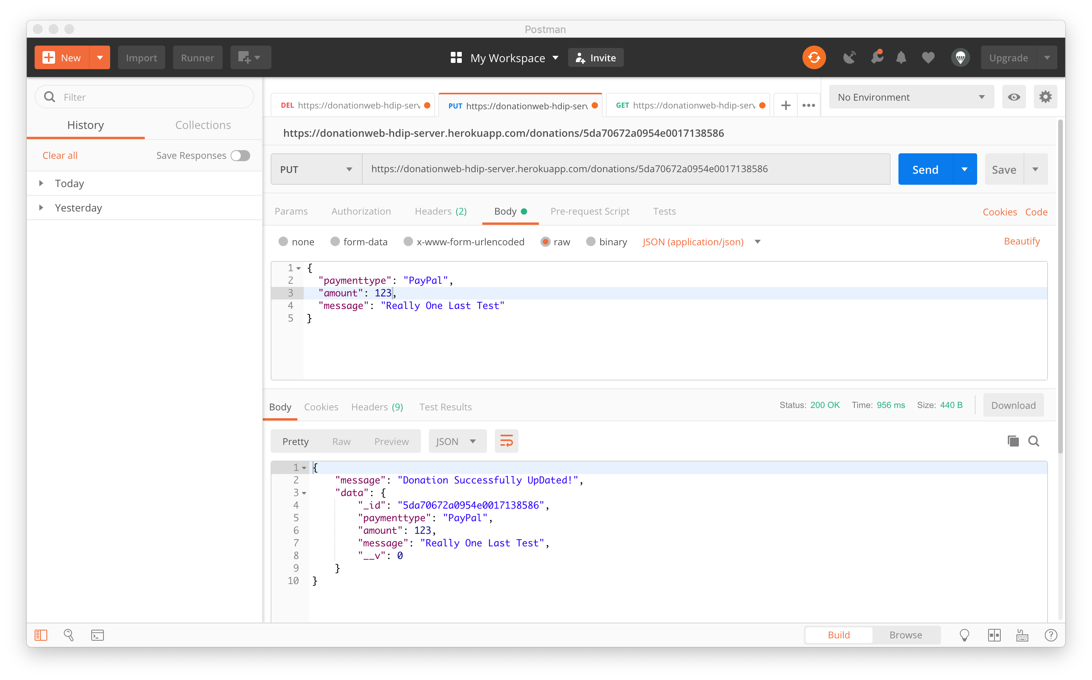
app.put('/donations/:id', donations.editDonation)

Slide 12
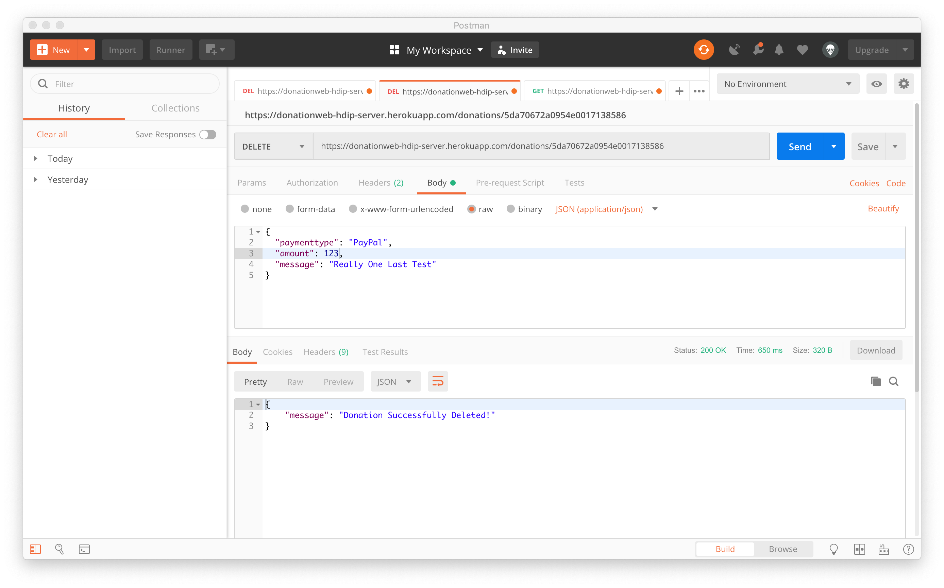
app.delete('/donations/:id', donations.deleteDonation)

Slide 13

References
https://donationweb-hdip-server.herokuapp.com

Slide 14
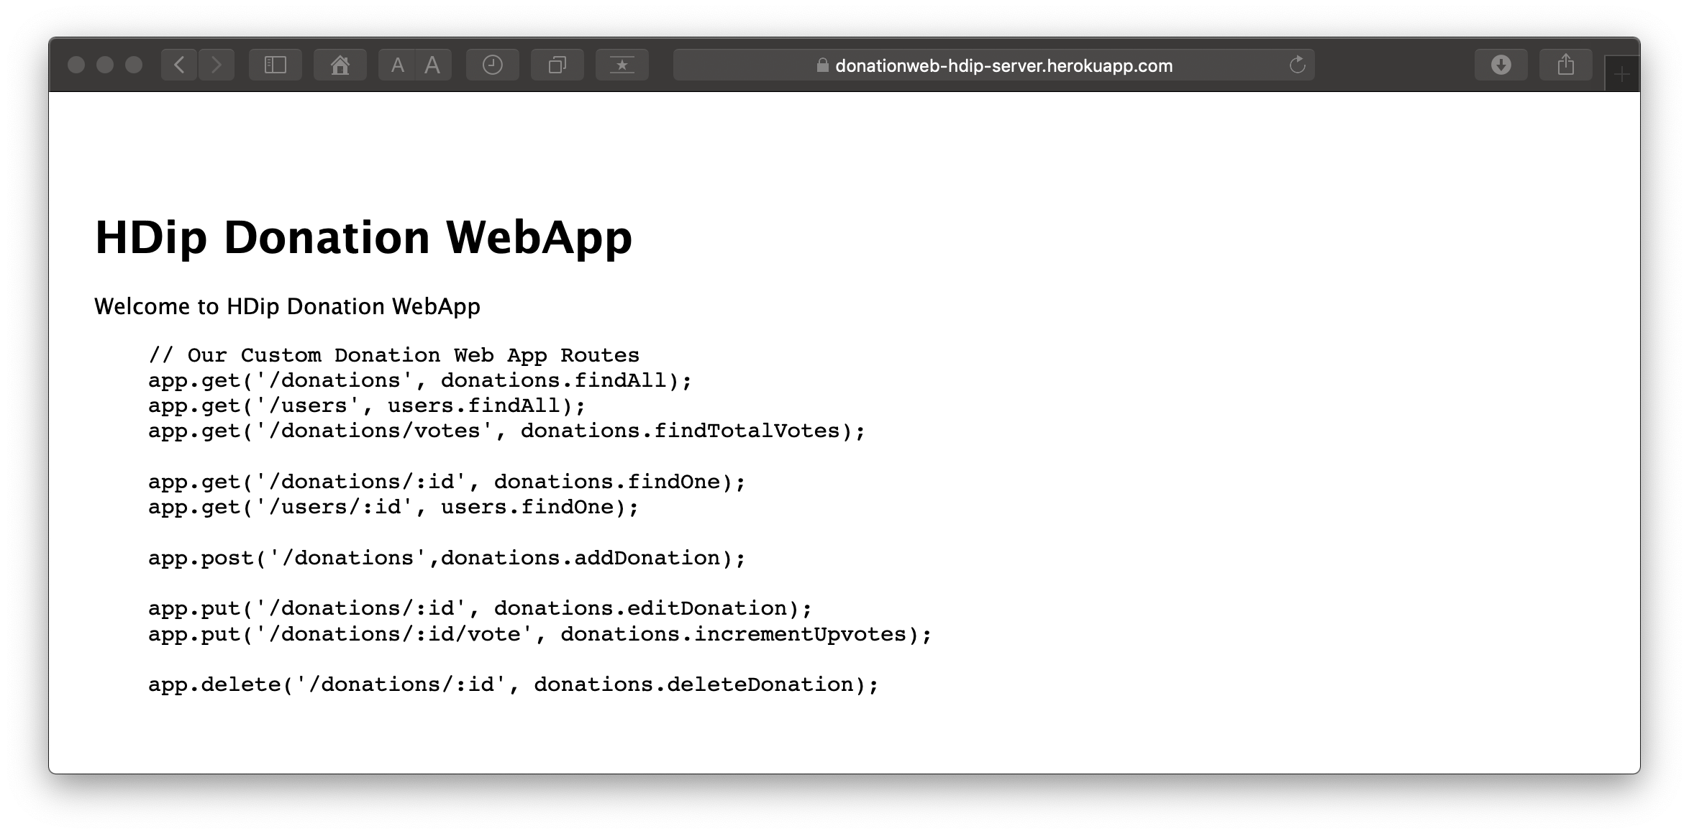

Slide 15


